Slide 1
Individual Healthcare Insurance
Presented by:
Steve Seto
Licensed Insurance Agent
States licensed in:
FLORIDA, AL, AR, AZ, CA, GA, IA, IN, IL, LA, ME, MI,, MO, NC, OH, OK, OR, PA, SC, TN, TX, UT, VA and WV

Slide 2
Your Health Insurance from Healthcare.gov (Florida Blue or Ambetter)
IDEAL CANDIDATES FOR PRIVATE INSURANCE
If you are Self Employed (and purchase your own health insurance)
If you and/or your children are on your spouse’s plan (and paying too much money)
And if you have any of the following concerns:
Your individual monthly payments are very high
Your deductibles are too high
It is hard to find quality doctors in your network
Then I have solutions for you!

Slide 3
Individual Health Insurance Options
You can work for a company that offers Group Health Plans
You can purchase a policy on Healthcare.gov Market Place
You can purchase Private Individual Health Insurance

Slide 4
WHY IS MY HEALTH INSURANCE SO HIGH?
In a normal world, you should have an actuarial quote, based on just you and your family’s ages and zip code.
Under your Healthcare.gov plan, you and your family are “pooled” in with individuals that have poor health, and as a result will increase your premium substantially!
Example: Family of Four
Adult Male – 30’s, non-smoker, healthy weight
Adult Female – 30’s, non-smoker, healthy weight
Two children – good health record

Slide 5
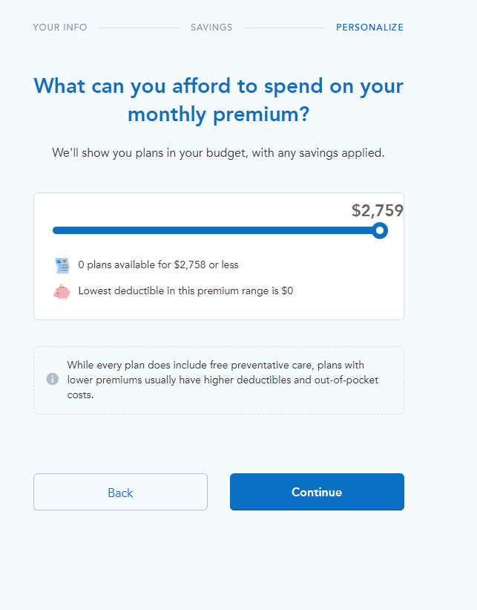
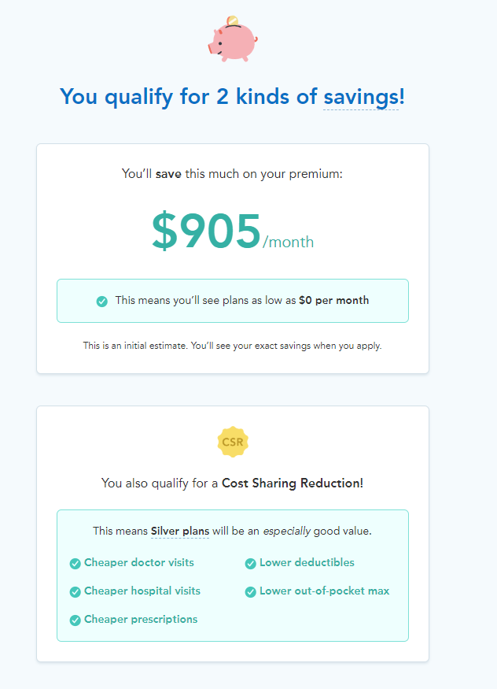
WHY IS MY HEALTH INSURANCE SO HIGH?
In a normal insurance process, your household income should have nothing to do with your health insurance premiums.
Healthcare.gov will offer “assistance or subsidy” if your household income is less than the average individual or family.
However, if your household income is above average, your premium will be higher to help offset subsidies.
I have illustrated that here
The first plan could be subsidized to $0, while the other plan is $2,759/month
This illustration is for the same exact family, and the only change is household income as projected on the Market Place (Healthcare.gov)

Slide 6
WHY IS MY HEALTH INSURANCE SO HIGH?
MEC = Minimum Essential Coverage
Four main reasons why your Florida Blue and Ambetter policies are so high in cost:
Paying for Minimum Essential Coverage you do not want or need
Being pooled in with others who are in poor health
Paying higher for your health insurance, simply because you make more money
Continued politics and instability of health insurance

Slide 7
“SHORT TERM” MEDICAL INSURANCE AS AN OPTION
All major Carriers offer Short Term Health Insurance
At one time, this was an option for only short term lengths, like going from old employer to a new employer, following a divorce or when a child is aging out of their parent’s policy
All major Insurance Companies offer Short Term Insurance
Short Term Insurance is an outstanding option, that “mimics” a Major Medical Plan. If you and your family have a good health history, you can purchase these plans, for 12, 24 or even 36 months and save lots of money

Slide 8
BENEFITS OF SHORT TERM HEALTH INSURANCE
Since Short Term Health Insurance plans are purchased by individuals with a fairly good health history, here are some advantages of these plans:
Lower monthly premiums (much lower than your individual or even your spouse’s group policy)
Lower deductibles
Superior networks, most likely with the best doctors and facilities
Nationwide PPO (Preferred Provider Organization) Network
Many practical benefits like, unlimited copays for Urgent Care and Telemedicine

Slide 9
STEPS TO DETERMINE IF THESE POLICIES ARE RIGHT FOR YOU
Text, email or call me with you (and your family’s) demographics and contact information
I will prepare and review a quote for you to look over
I read you Eligibility Questionnaire (health questions) to qualify you
Enroll you (for any effective date you choose)

Slide 10
Fantastic insurance companies that can offer you and your family affordable and comprehensive coverage

Slide 11
Thanks!
Steve Seto
sseto@myhst.com
www.sseto.myhst.com
941.993.4137
You can text, email, or call me
Monday – Sunday, from 8:00 a.m. EST t0 7:00 p.m. EST

